Slide 1
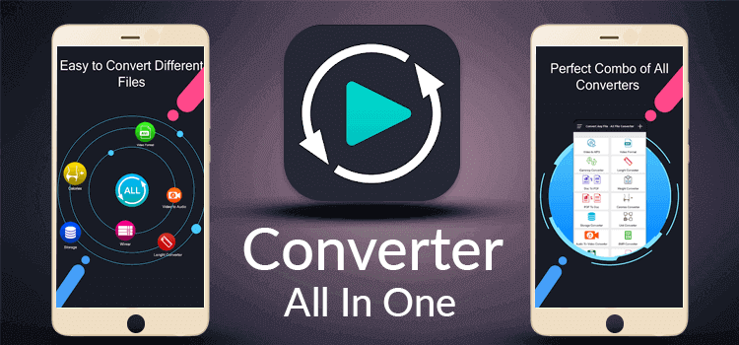

Team name:- Codding Heroes Project name: Ours Converter
Let us Start

Slide 2



OUR TEAM Member
Shahsultan islam joy
Asiqur Rahman
Tayeb Hossan
junior MERN stack developer
As a junior Full stack developer and Team leader
junior MERN stack developer

Slide 3
All OF CONTENTS
01
02
Navbar
About us
03
04
Converter
Authentication
Adding react-router
You can describe the topic of the section here
Image to pdf
Photo Editing
1. Signup
2. Login with

Slide 4
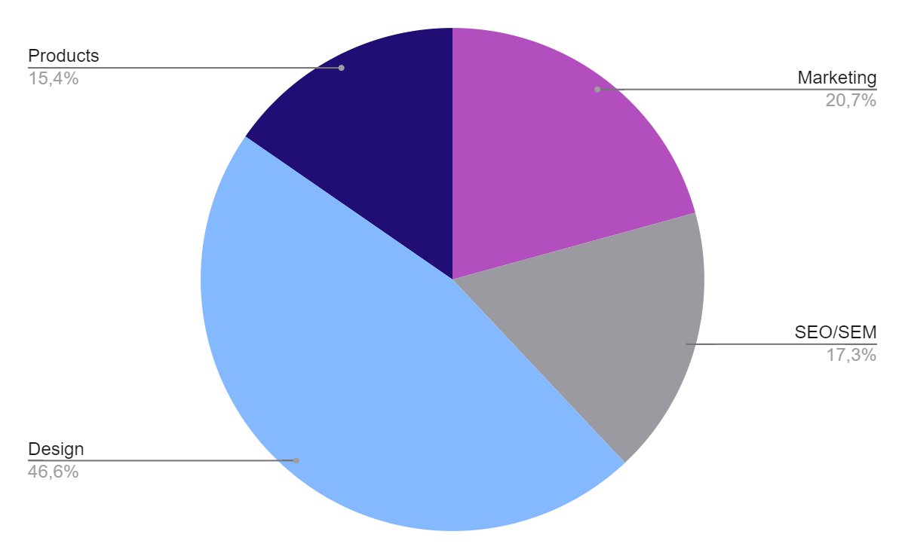
Ours conveter
Image Editing
Conveter part
DESIGN
Authenticaton
Despite being image editing easy way
Image to pdf convert
Tailwind CSS, tailwind css popular framework .keept react
Login and signup page

Slide 5
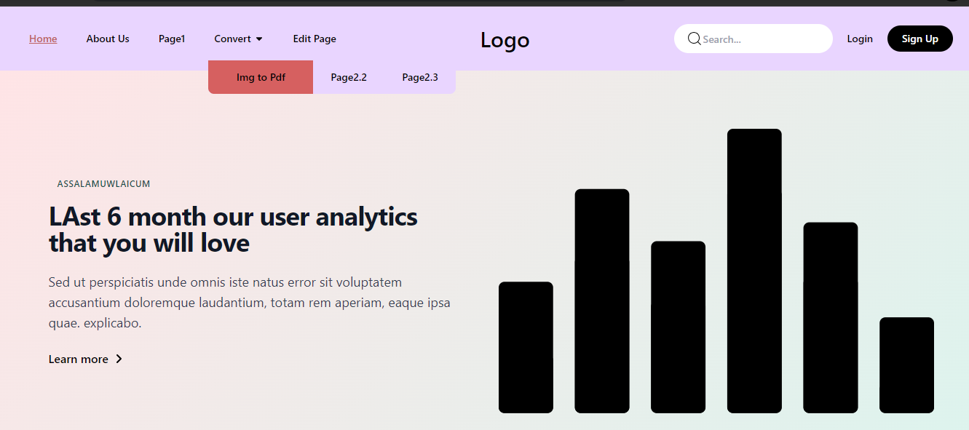
01
Navbar
e're using the Link component from React Router to handle navigation within the application. If you're not using React Router, you can replace Link with regular anchor (<a>) tags.
using the Link component from React
Router to handle navigation within the application. If you're not using React Router,
you can replace the Link with a regular anchor
(<a>) tags.

Slide 6
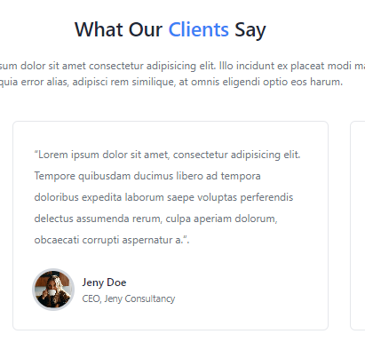
2.1
Testimonials
testimonials or customer feedback, are client feedback. There are many websites and platforms where individuals and businesses.

Slide 7

02
About us
Welcome our talented teams of professionals. the incredibly talented teams of professionals who make our shared vision a reality.

Slide 8
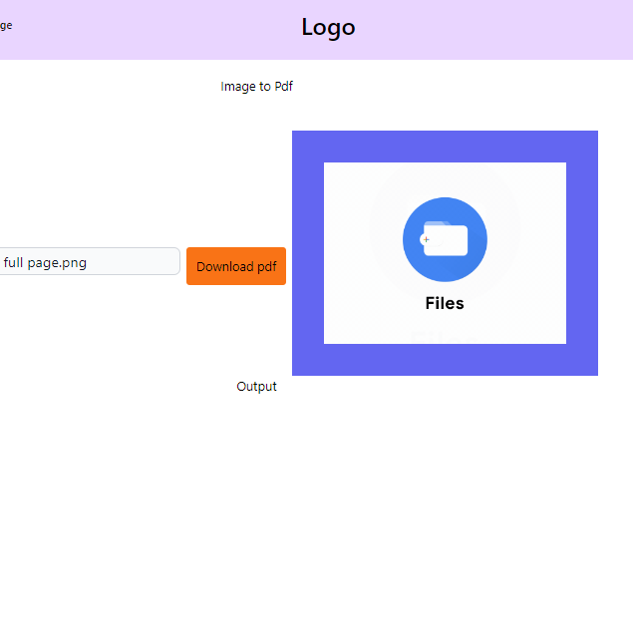
03
Image to pdf
To convert images to PDF in a React.js application, you can use a library like react-pdf for rendering PDFs and react-image-file-resizer to resize and convert images to a format compatible with PDF. Below is an example of how you might implement this in a React.js application:
To convert images to PDF in a React.
js application, you can use a library like react-pdf
for rendering PDFs and react-image-file-resizer
to resize and convert images to a format compatible with PDF.

Slide 9
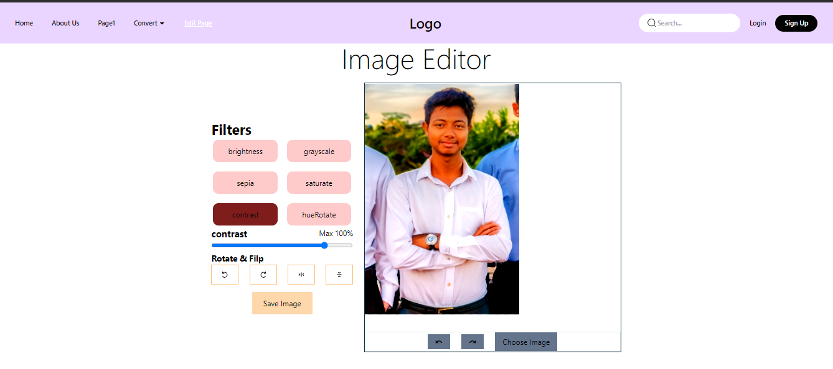
04
Image Editing
To implement image editing functionality in a React.js application, you can use various libraries that provide image manipulation capabilities.

Slide 10

05
Authentication
Firebase Authentication is a service.
Email/Password Authentication: firebase allows users to sign up and sign in using their email and password.
social Logins: such as Google, GitHub

Slide 11
Thank you all for being with us this long for

